Slide 1

Object Oriented Programming
Behavioral Design Patterns: Command
IT620
Sourish Dasgupta
Assistant Professor, DA-IICT, Gandhinagar
https://daiict.ac.in/faculty/sourish-dasgupta

Slide 2
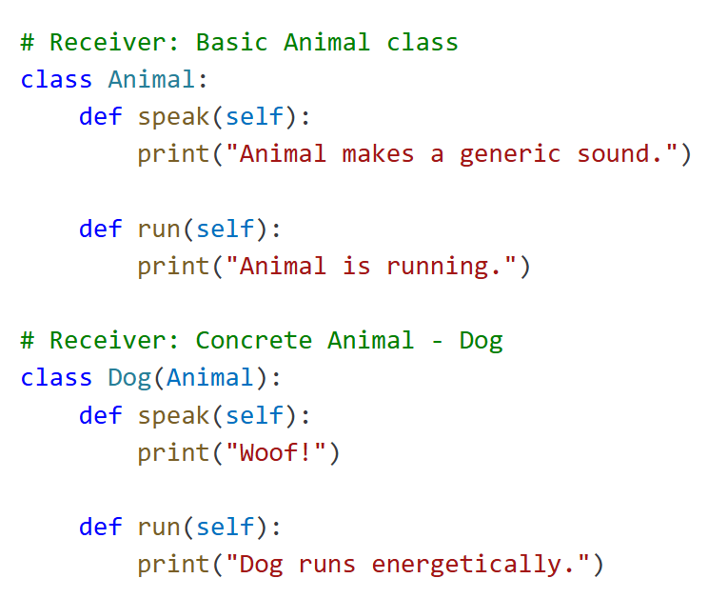
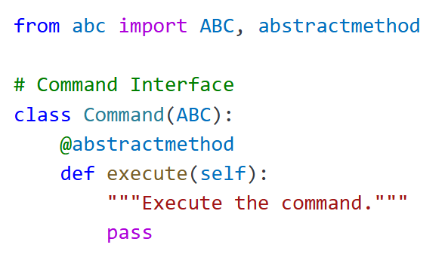
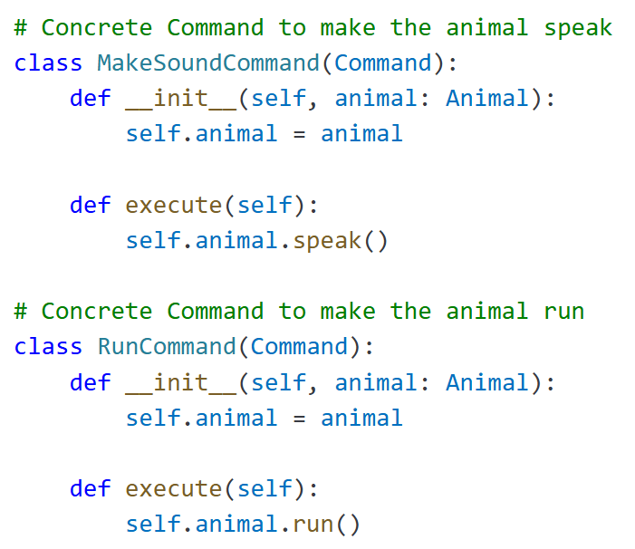
What if objects want to talk to each other via “messengers”?
IT620: Behavioral Design Patterns: Command
Sourish Dasgupta

Slide 3
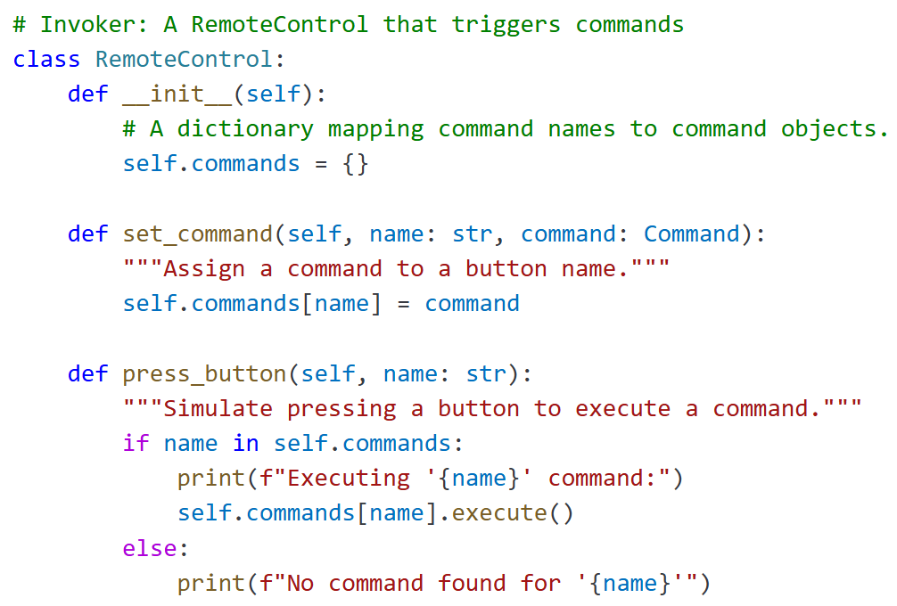
What if objects want to talk to each other via “messengers”?
IT620: Behavioral Design Patterns: Command
Sourish Dasgupta

Slide 4
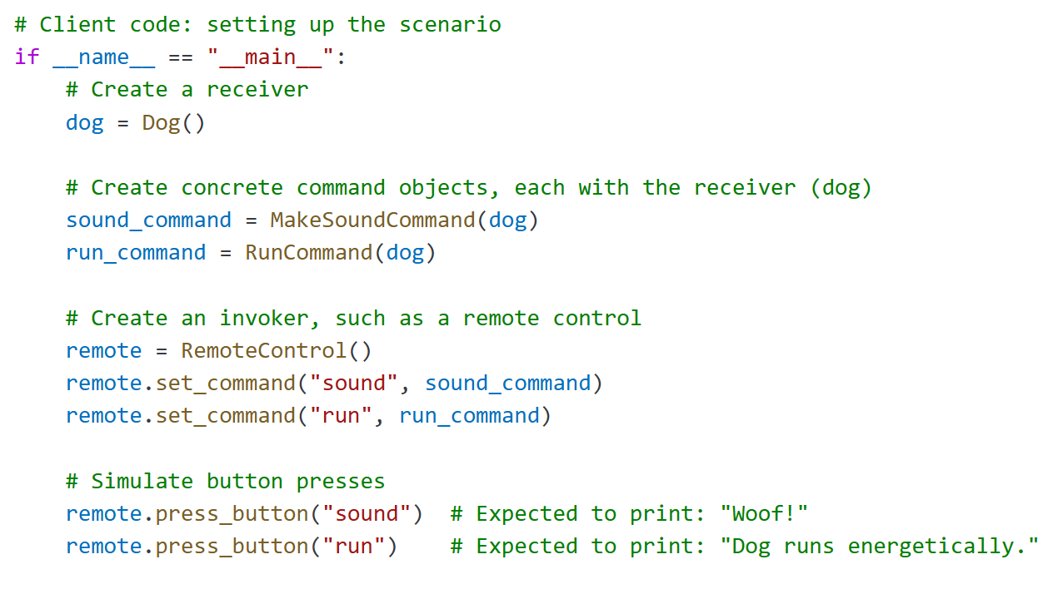
The sender → messenger → receiver paradigm
IT620: Behavioral Design Patterns: Command
Sourish Dasgupta

Slide 5
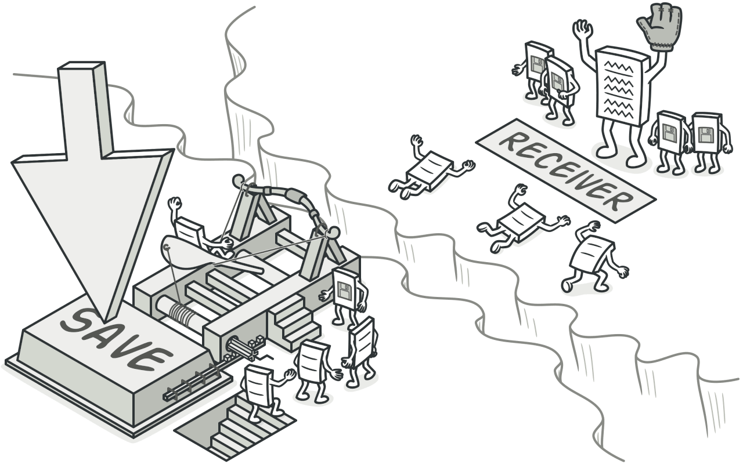
The sender → messenger → receiver paradigm
IT620: Behavioral Design Patterns: Command
Sourish Dasgupta

Slide 6
Why Command?
Benefit | Description
Decoupling | Separates the object that invokes the command (Invoker) from the one that knows how to execute it (Receiver)
Extensibility (SOLID) | New commands can be added without changing existing code (open/closed principle).
Reusability | Commands can be reused across different invokers or contexts.
Undo/Redo Support | Commands can store state for undo/redo functionality
Command Queuing/Logging | Commands can be stored, logged, or executed later (e.g., task queues)
Macro Commands | Multiple commands can be combined into one command to execute in sequence.
Flexible Invocation | Commands can be parameterized, passed as arguments, or triggered in various ways
IT620: Behavioral Design Patterns: Command
Sourish Dasgupta

Slide 7
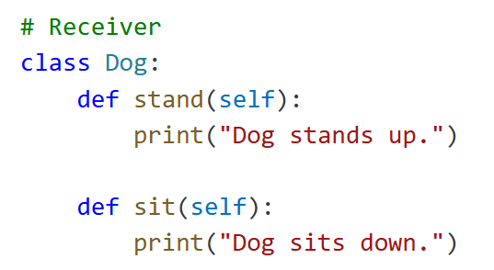
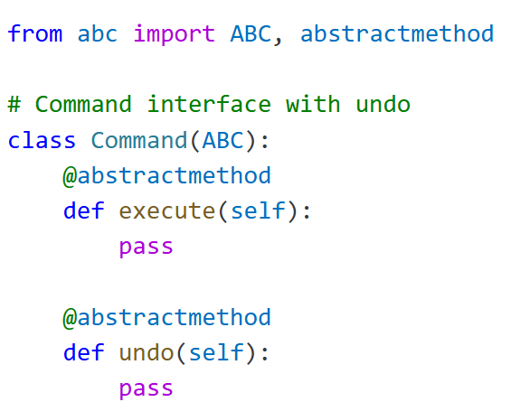
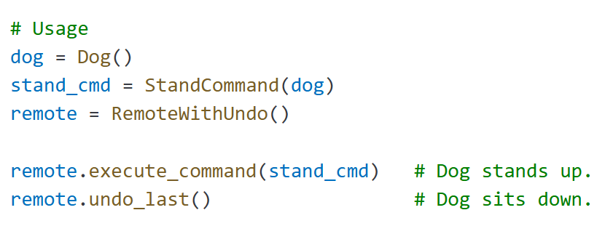
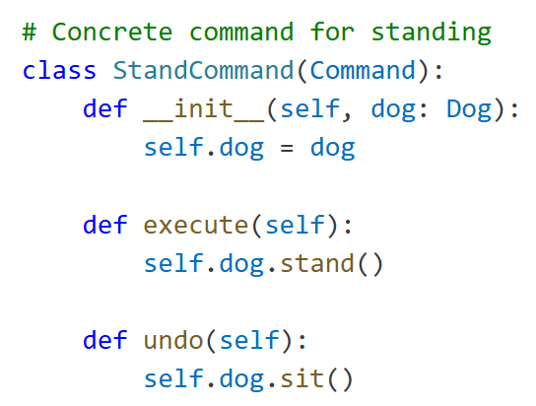
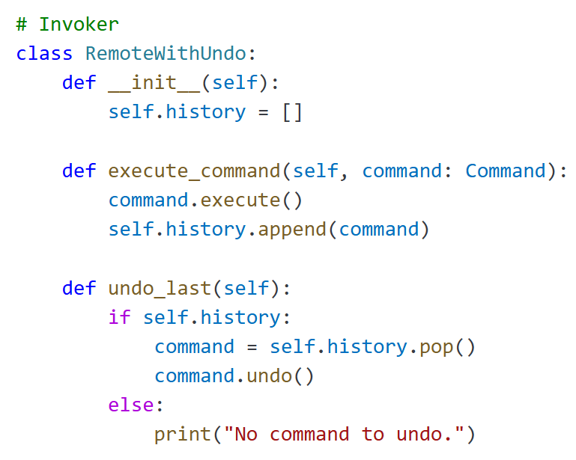
How to get “undo” done?
IT620: Behavioral Design Patterns: Command
Sourish Dasgupta

Slide 8
How to get “undo” done?
IT620: Behavioral Design Patterns: Command
Sourish Dasgupta

Slide 9
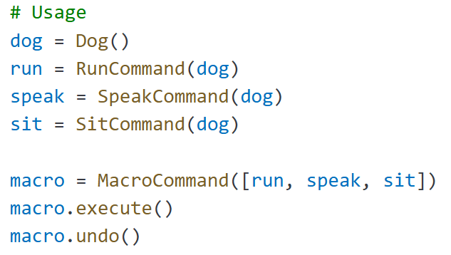
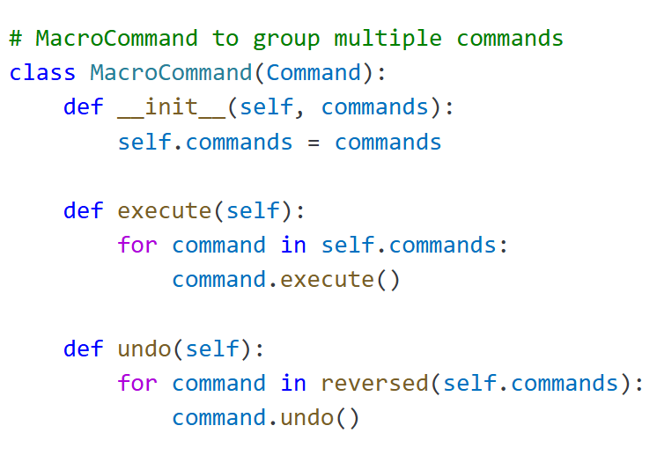
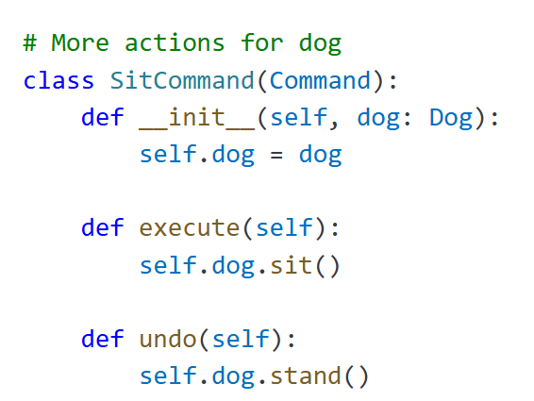
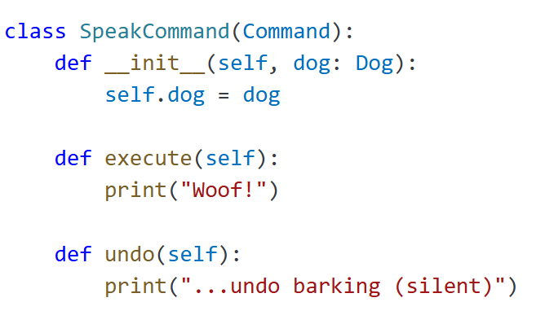
How to “compose commands (macro)”?
IT620: Behavioral Design Patterns: Command
Sourish Dasgupta

Slide 10
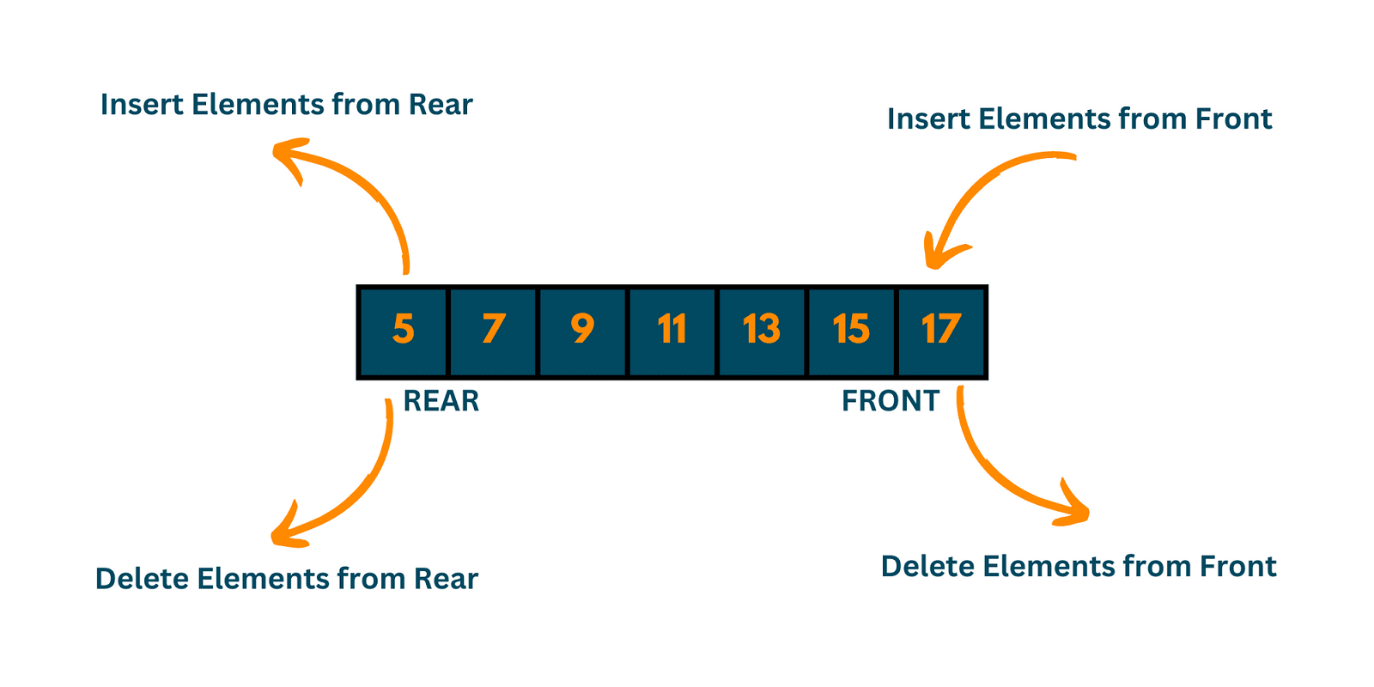
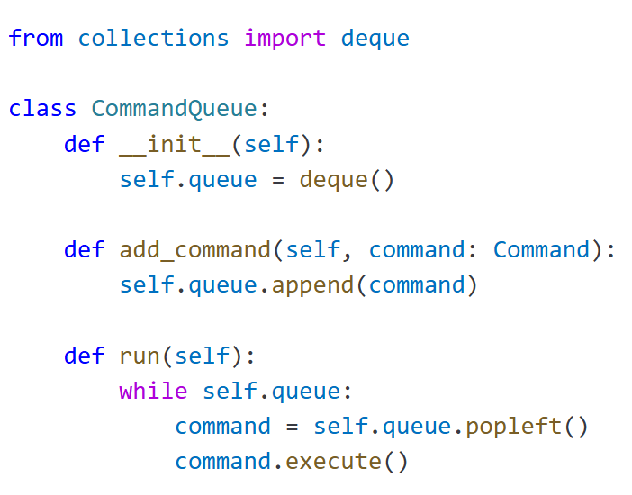
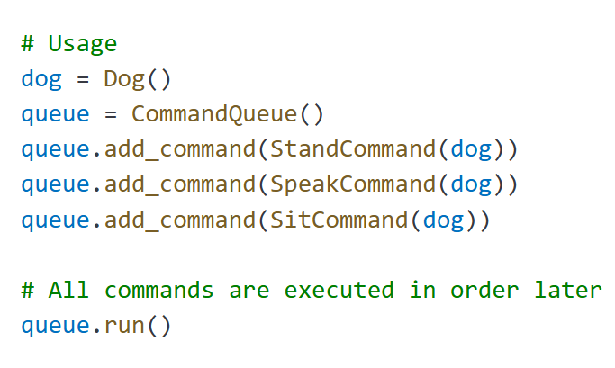
How to “queue up commands”?
IT620: Behavioral Design Patterns: Command
Sourish Dasgupta

